Slide 1
Chapter 3
Using Network Communication Protocols

Slide 2
Object
• Explain network protocols including TCP, UDP, and IP
• Discuss how IP addressing works
• Understand IPv4 and IPv6
• Explain and use application protocols in the TCP/IP suite
• Explain VoIP
• Compare TCP/IP to the OSI model
• Discuss WAN protocols used for remote communications
• Understand how to design a network to use TCP/IP and application protocols
http://fpt.edu.vn

Slide 3
An Overview of Network Protocols
Properties of a LAN Protocol
LAN protocol include capabilities to do the following:
• Enable reliable network links
• Communicate at relatively high speeds
• Handle source and destination node addressing
• Follow standards, particularly the IEEE 802 standards
http://fpt.edu.vn
Notes:
Read carefully the scenario in Chapter 6

Slide 4
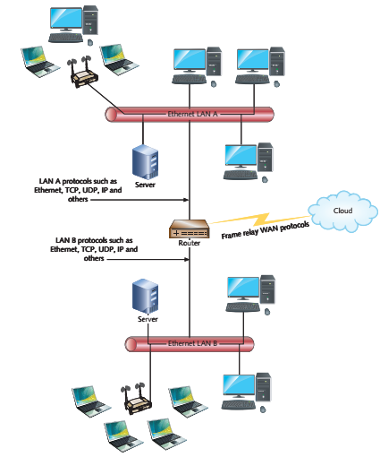
An Overview of Network Protocols
LAN Protocols and Operating Systems
- TCP/IP, IPX/SPX, NetBEUI, and AppleTalk
http://fpt.edu.vn

Slide 5
Legacy Protocols
IPX/SPX (Internetwork Packet Exchange / Sequenced Packet
Exchange)
Developed by Novell, called NetWare
Ethernet bus, token ring, and ARCnet networks that employed one file server
NetBEUI (NetBIOS Extended User Interface)
Developed by IBM and Microsoft for LAN Manager and LAN Server
Windows 2000 (NetBEUI is not supported in Windows XP, Windows
Server 2003, or any higher)
http://fpt.edu.vn

Slide 6
Legacy Protocols
AppleTalk
Developed the AppleTalk
Protocol suite to network Macintosh computers running the
Mac OS operating system
AppleTalk is a peer-to-peer network protocol
Mac OS X version 10.6 (Snow Leopard) AppleTalk is no longer supported
http://fpt.edu.vn

Slide 7
TCP/IP
- The most widely used protocol suite and the protocol of the Internet
- Most network server and workstation support TCP/IP: UNIX, Linux, Windows, Novell Open Enterprise Server, Mac OS X, and IBM power
The History and Role of TCP/IP
  In the late 1960s, the Advanced Research Projects Agency (ARPA) was working to make the ARPANET
  The Transmission Control Protocol (TCP) and the Internet Protocol (IP)
http://fpt.edu.vn

Slide 8
TCP/IP
Advantages of TCP/IP
• It is used on most networks and the Internet, which makes it the international language of network communications.
• There is a wide range of network devices designed for use with TCP/IP.
• Most computer operating systems use TCP/IP as their main protocol.
• There are many troubleshooting and network analysis tools available for TCP/IP.
• There is a large body of network professionals who understand TCP/IP.
http://fpt.edu.vn

Slide 9
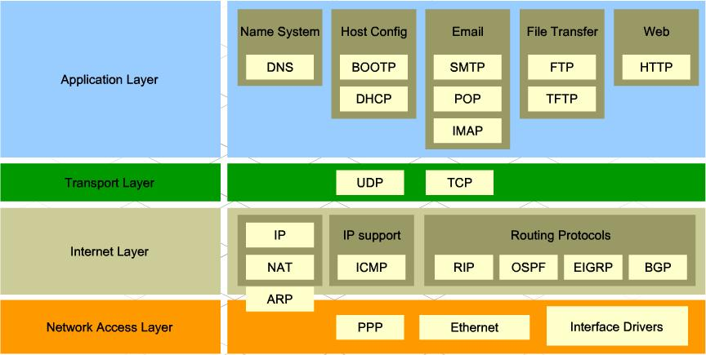
Protocols and Applications of the TCP/IP Suite
The core component protocols within the TCP/IP suite are:
• Transmission Control Protocol (TCP)
• User Datagram Protocol (UDP)
• Internet Protocol (IP)
http://fpt.edu.vn

Slide 10
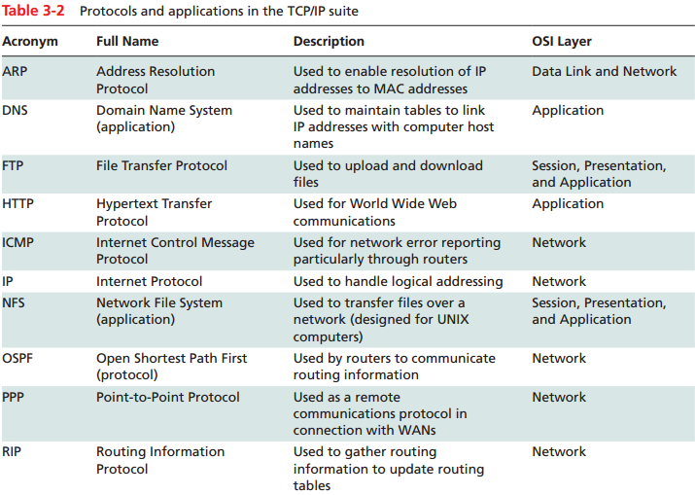
Protocols and Applications of the TCP/IP Suite
http://fpt.edu.vn

Slide 11
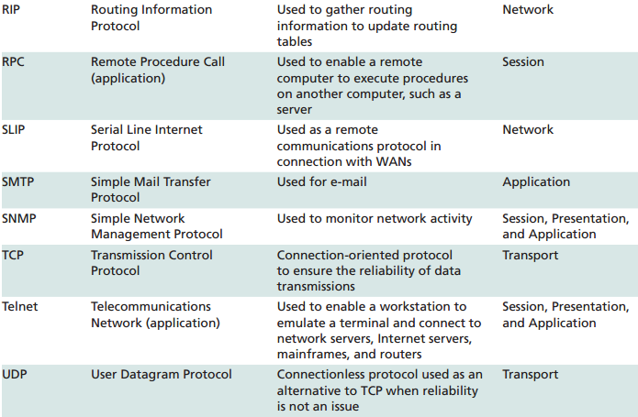
Protocols and Applications of the TCP/IP Suite
http://fpt.edu.vn

Slide 12
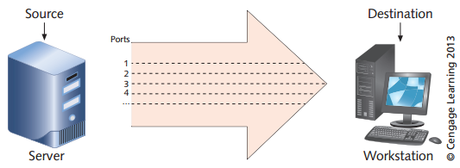
TCP/IP
How TCP/UDP Works
Establishes communication sessions between software application
TCP accomplishes this by sequencing
and acknowledging frames.
Establish a sequence number for each frame that is transmitted
Sliding window
  Monitor for session requests
  Establish sessions with other TCP nodes
  Transmit and receive data
  Close transmission sessions
http://fpt.edu.vn

Slide 13
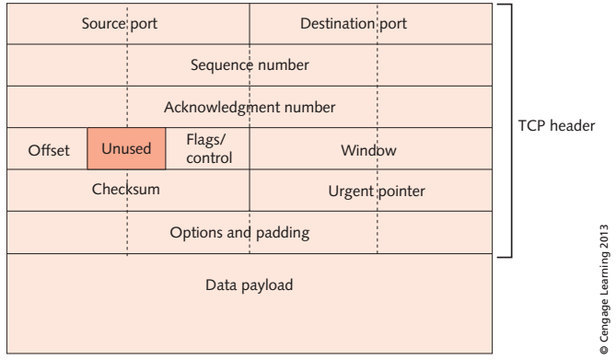
http://fpt.edu.vn

Slide 14
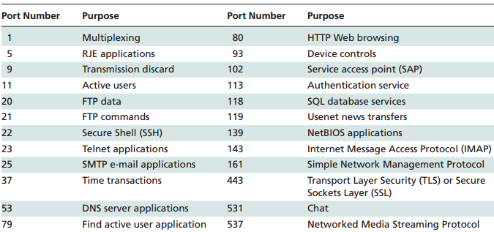
http://fpt.edu.vn

Slide 15
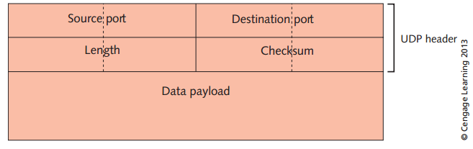
How the User Datagram Protocol (UDP) Works
The TCP/IP suite has the option to transmit data in connectionless streams containing virtually no overhead on top of the IP-based datagrams that are sent
UDP does not provide the same level of reliability and error checking
http://fpt.edu.vn

Slide 16
How the Internet Protocol (IP) Works
Internet Protocol (IP) enables a packet to reach different subnetworks on a LAN and different networks on a WAN
• Ethernet • FDDI
• ISDN • DSL
• Frame relay • ATM (with conversion)
• MPLS • SONET
http://fpt.edu.vn

Slide 17
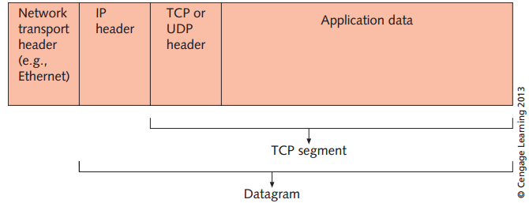
How the User Datagram Protocol (UDP) Works
Provide for data transfer, packet addressing, packet routing, fragmentation, and simple detection of packet errors
IP as a Connectionless Protocol
Network-to-network addressing
Routing information
http://fpt.edu.vn

Slide 18
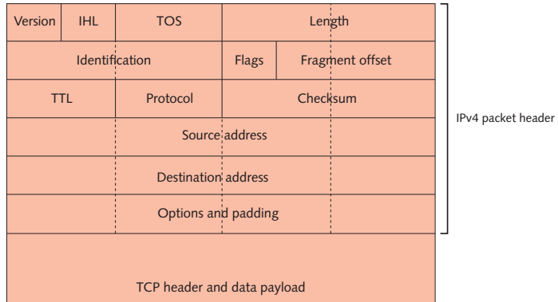
IP packet v4
http://fpt.edu.vn

Slide 19
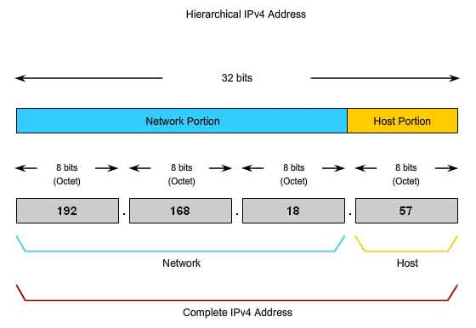
Using IPv4 and IPv4 Addressing
Identify a specific node and the network
Basic IPv4 Addressing
  32 bits long (10000001.00000101.00001010.01100100)
  129.5.10.100 in decimal format
  five IP address classes: A, B, C, D, E
  assigned by the Internet Assigned Numbers Authority (IANA)
  The address 127.0.0.1 is traditionally called the loopback address
http://fpt.edu.vn

Slide 20
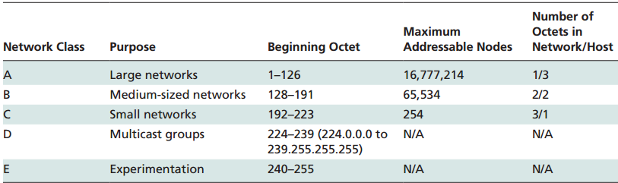
Using IPv4 and IPv4 Addressing
http://fpt.edu.vn

Slide 21
Using IPv4 and IPv4 Addressing
The Role of the Subnet Mask
  TCP/IP addresses require a configured subnet mask
  show the class of addressing used
  divide a network into subnetworks to control network traffic
  network ID & host ID
Creating Subnetworks
  divide a network into a series of smaller networks
  Classless Interdomain Routing (CIDR) addressing
  CIDR provides more IP address options for medium-sized networks
http://fpt.edu.vn

Slide 22
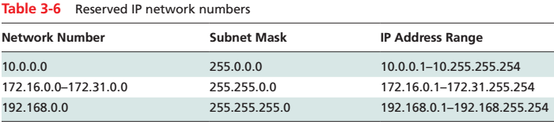
Using IPv4 and IPv4 Addressing
IPv4 Address Rules
  The network number 127.0.0.0 cannot be assigned to any network
  The standard implementation of TCP/IP also reserves a series of addresses known as private addresses
  They are designed for use on a private network behind a Network Address Translation (NAT) device
http://fpt.edu.vn

Slide 23
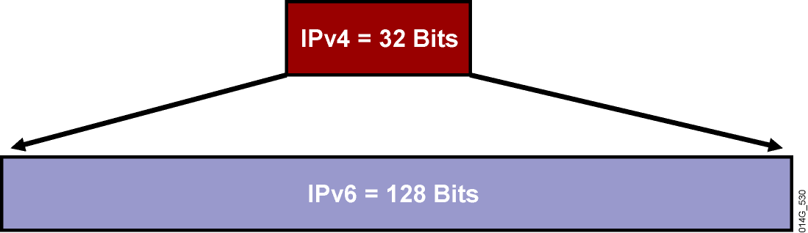
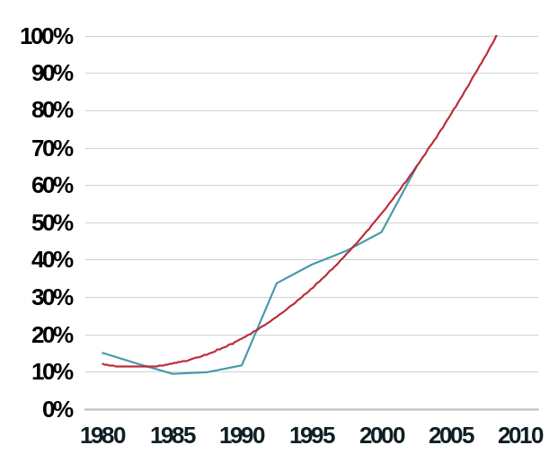
Using IPv6 and IPv6 Addressing
IPv4
32 bits or 4 bytes long
4,200,000,000 possible addressable nodes
IPv6
128 bits or 16 bytes:
four times the bits of IPv4
3.4 * 10³⁸ possible addressable nodes 340,282,366,920,938,463,374,607,432,768,211,456
5 * 10²⁸ addresses per person
http://fpt.edu.vn

Slide 24
Using IPv6 and IPv6 Addressing
x:x:x:x:x:x:x:x, where x is a 16-bit hexadecimal field
Leading zeros in a field are optional:
  2031:0:130F:0:0:9C0:876A:130B
Successive fields of 0 can be represented as ::, but only once per address.
Examples:
  2031:0000:130F:0000:0000:09C0:876A:130B
  2031:0:130f::9c0:876a:130b
  FF01:0:0:0:0:0:0:1 >>> FF01::1
  0:0:0:0:0:0:0:1 >>> ::1
  0:0:0:0:0:0:0:0 >>> ::
http://fpt.edu.vn

Slide 25
Header IPv4 & IPv6
Version
IHL
Type of
Service
Total Length
Version
Traffic
Class
Flow Label
Identification
Flags
Fragment
Offset
Payload Length
Next
Header
Hop Limit
Time to Live
Protocol
Header Checksum
Source Address
Source Address
Destination Address
Options
Padding
Field’s Name Kept from IPv4 to IPv6
Fields Not Kept in IPv6
Name and Position Changed in IPv6
New Field in IPv6
Destination Address
Legend
http://fpt.edu.vn

Slide 26
TCP/IP Application Protocols
TCP/IP is designed protocols for e-mail, terminal emulation, file transfers, routing, network management, and other services
http://fpt.edu.vn

Slide 27
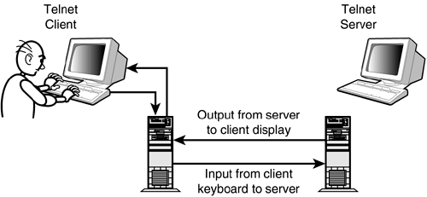
Telnet
Provides support for terminal emulation
A terminal is a device that consists of a monitor and keyboard
Terminal emulation involves using software to make a computer
Enables a user to connect to a host computer so that the host responds as though it were connected to a terminal
Telnet uses TCP port 23 at the sender and receiver for dedicated communications.
http://fpt.edu.vn

Slide 28
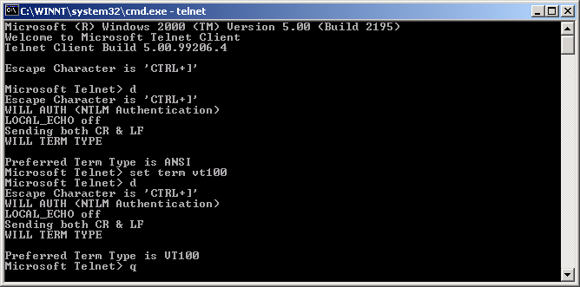
Telnet
Telnet includes communications options such as:
- Seven- or eight-bit compatibility
- Use of different terminal modes
- Character echoing at the sending and receiving ends
- Synchronized communications
- Transmission of character streams or single characters
- Flow control
http://fpt.edu.vn

Slide 29
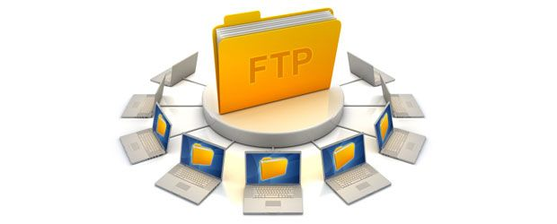
FTP, TFTP, and NFS
Upload and download file over Internet Network
Transfer of data from one remote device to another
FTP, TFTP, NFS data transmissions are reliable and ensured by connection-oriented services
http://fpt.edu.vn

Slide 30

Simple Mail Transfer Protocol (SMTP)
Designed for the exchange of e-mail between networked
systems
E-mail messages have two parts:
  An address header
  The message text
http://fpt.edu.vn

Slide 31
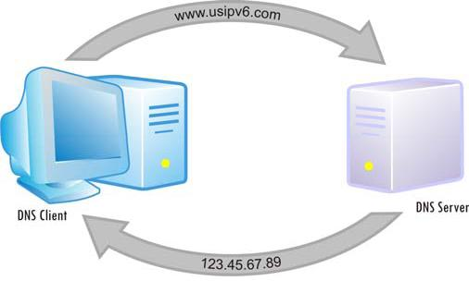
Domain Name System (DNS)
Converts a computer or domain name to an IP address
Converts an IP address to a computer or domain name
This process is called “resolution.”
UDP port 53
http://fpt.edu.vn

Slide 32
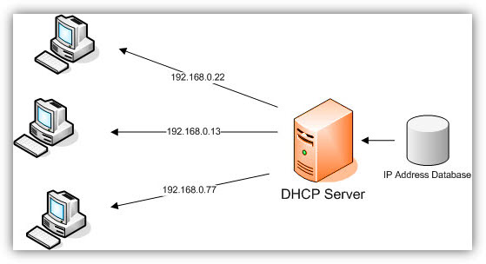
Dynamic Host Configuration Protocol (DHCP)
Used to enable IP addresses to be assigned automatically
http://fpt.edu.vn

Slide 33
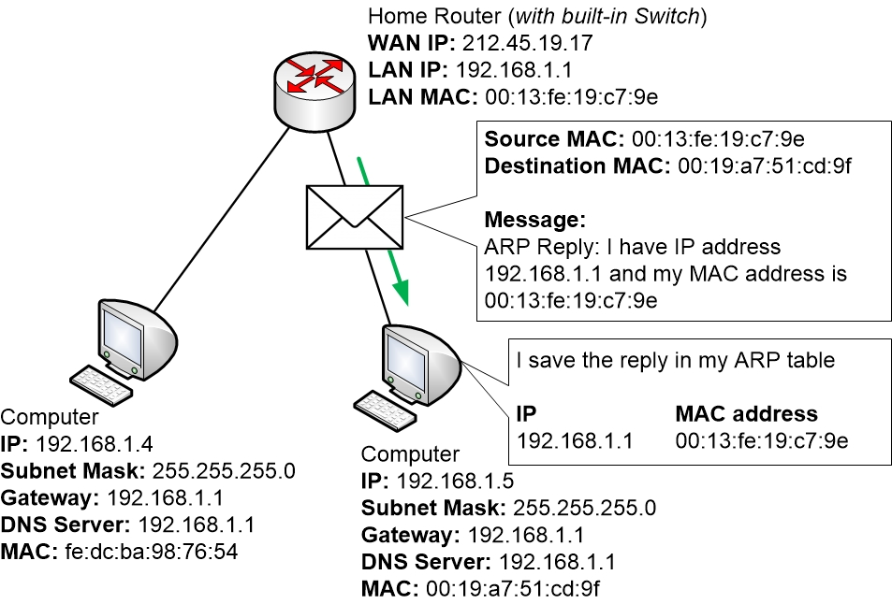
Address Resolution Protocol (ARP)
The sender needs both the IP and MAC addresses to send a packet to its destination
http://fpt.edu.vn

Slide 34
Q & A
http://fpt.edu.vn

